Slide 1

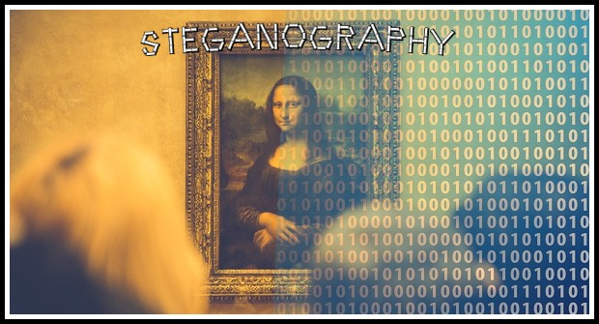
IMAGE STEGANOGRAPHY

Slide 2
CONTENT
What is Steganography
Steganography v/s Cryptography
Types
Characteristics of Steganography Techniques
Steganographic model
Dissecting Steganography
Steganalysis

Slide 3
CONTENT ………
Steganographic tools
Disadvantages
Methodology
System Specification

Slide 4

WHAT IS STEGANOGRAPHY
Steganography is an art and science of hiding information by embedding it in some other data.
Steganography word comes from Greek word. ‘Stegano’ = covering or hiding, ‘graphen’ = writing.

Slide 5
STEGANOGRAPHY VS CRYPTOGRAPHY
Cryptography and steganography are both methods used to hide or protect secret data. However, they differ in the respect that cryptography makes the data unreadable, or hides the meaning of the data, while steganography hides the existence of the data.
Cryptography alter the overall structure of data.
Steganography does not alter the overall structure of the data

Slide 6
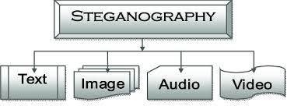
TYPES OF STEGANOGRAPHY
Image steganography
Textual steganography
Audio steganography
Video steganography
Ø

Slide 7
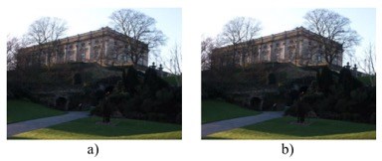
CHARACTERISTICS OF STEGANOGRAPHY TECHNIQUES
Transparency
Robustness

Slide 8
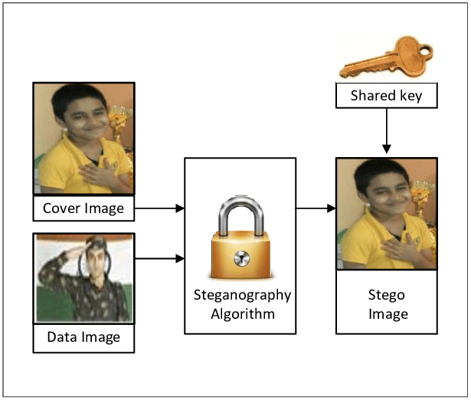
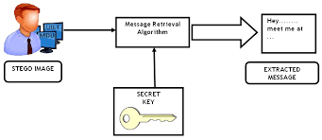
STEGANOGRAPHIC MODEL

Slide 9
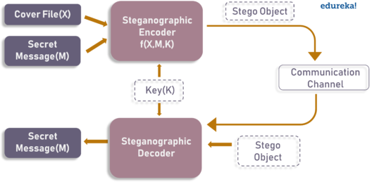
BLOCK DIAGRAM

Slide 10
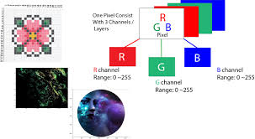
DISSECTING STEGANOGRAPHY
Steganography is a term used for hiding message within an image. Any colour pixel is made of a combination of red gren blue mode(RGB) where in each RGB component consist of 8 bits. If letters in ASCII are to be represented within the colour pixels, the rightmost digit, called the least significant bit(LSB), can be altered.

Slide 11
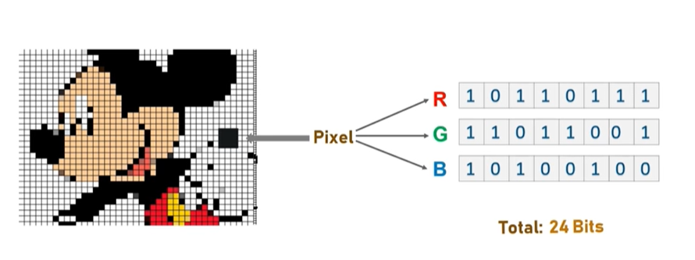
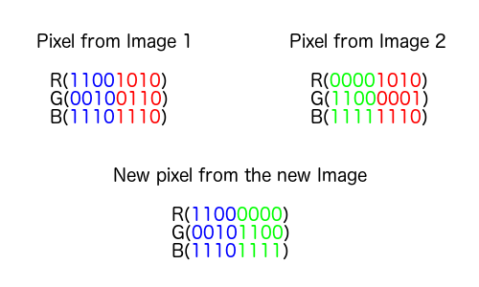
DISSECTING STEGANOGRAPHY……..

Slide 12
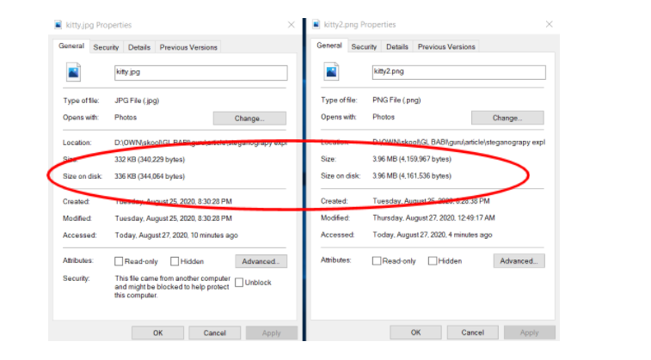

Slide 13
WHAT IS “STEGANALYSIS”
The art of detecting, decoding and altering messages hidden via steganography is called steganalysis. It is easiest when before as well as after steganography copies of file are present.
Steganalyist can make the hidden data work against the creator. Any malicious interceptor could alter as carrier file without the knowledge of sender or the intended receiver. Hence inaccurate or wrong data could be passed under identity of the original sender.

Slide 14
STEGANOGRAPHIC TOOLS
Xiao steganography:Xiao Steganography is free software that can be used to hide secret files in BMP images or WAV files. Using the tool is easy: you can just open the software and load any BMP image or WAV file to its interface. Then add a file you want to hide.
Steghide: Steghide is open-source steganography software that lets you hide your secret file in an image or audio file. You will not notice any change in the image or audio file. However, your secret file will be inside the original image or audio file.
Crypture: is another command-line tool that performs steganography. You can use this tool to hide your sensitive data inside a BMP image file. But there is one requirement: the BMP file should be eight times larger than the data file you want to hide inside the BMP file. If you have a small amount of data to hide, you can use this tool.

Slide 15
METHODOLOGY
The proposed technique try to minimize the data lost at the receiver side by solving disadvantage of overlapping during extraction problem.
Here secret text is embedded as target data within a cover Image.
The amplitude value of cover Image is normalized to 16 bit. During embedding first the data is preprocessed then inserted using modulo operator.

Slide 16
SYSTEM SPECIFICATIONS
Hardware:
Processor : Intel core i7
Hard Disk: 250 GB.
Mother Board:Intel chipset Board
Mouse: Logitech.
RAM: 8GB
Software:
Operating System: Windows XP/ Windows 7 Software Tool: Python
Devolopment Environment:MS Visual Studio net Framework4.5
Coding Language:Python.

Slide 17
ADVANTAGES OF STEGANOGRAPHY
ØIt can be used for safeguarding data, such as in the field of media where copywriting ensures authenticity.
ØIt can be used by intelligence agencies for sending their secret data.

Slide 18
DISADVANTAGE OF STEGANOGRAPHY
Many a terrorist and anti humanist activities have been carried out cloaked under this technique.

Slide 19
THANK YOU

